Slide 1
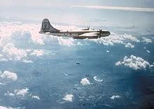
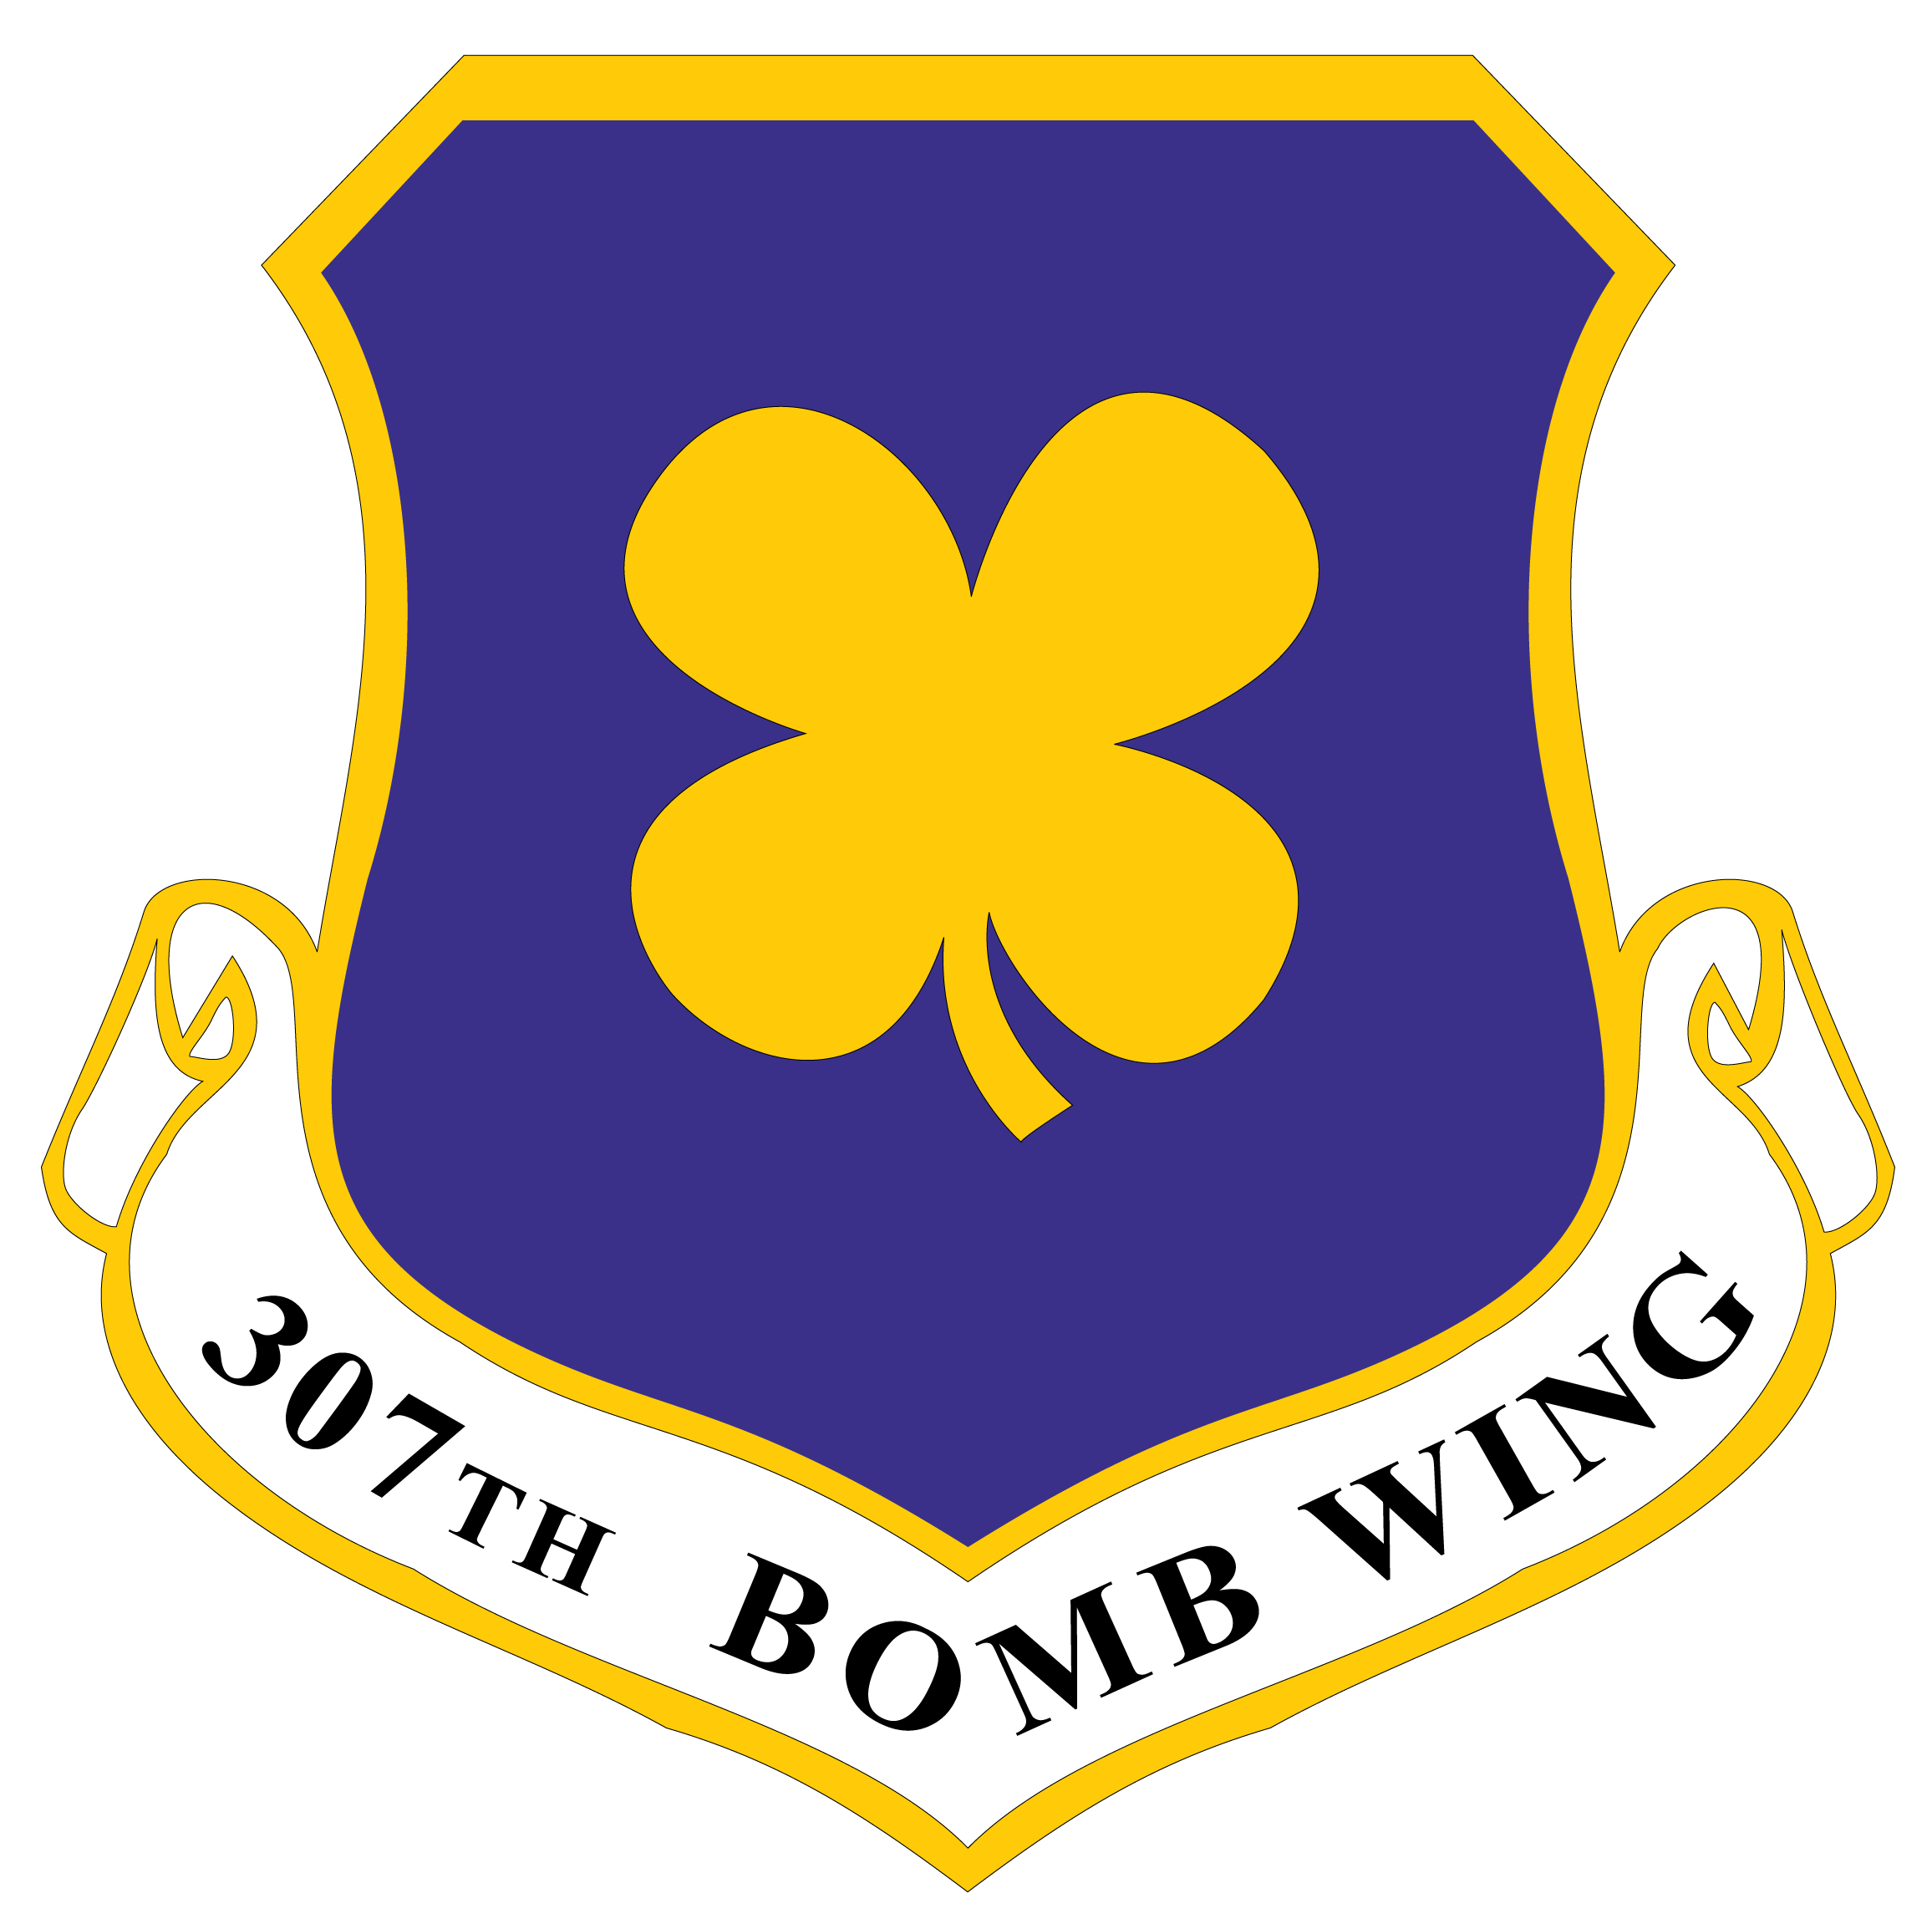
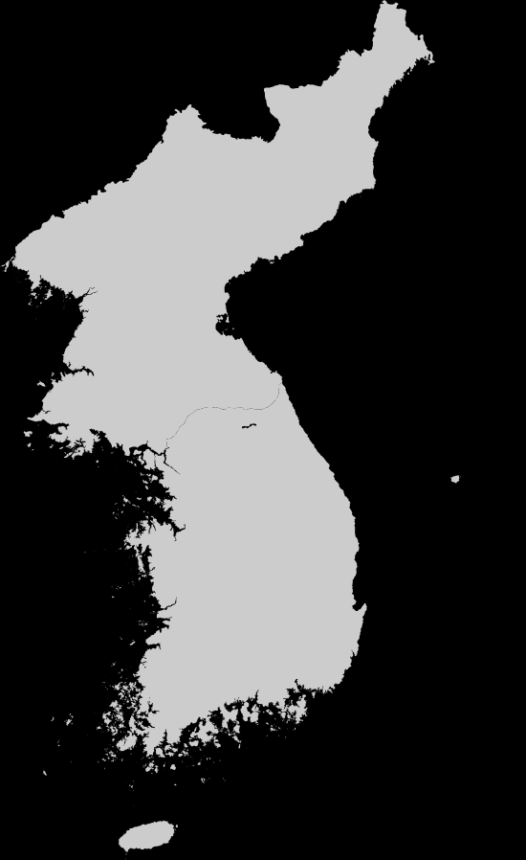
The 307th Bombardment Group Association Presents: 3 Outrageous Insights on the 307th in the Korean War
I can do all things through Christ which strengtheneth me.
Philippians 4:13 KJV
Notes:
Thank you for that introduction…
I count it a privilege to be here with you tonight as a member of the 307th Bombardment Group Association. For a couple of decades we have promoted the Long Rangers’ World War II legacy. Now we aim to extend that mission to the Korean War, and we seek your collaboration.
History treats the Korean War as a tragedy, a “Forgotten War.” Even the few published tactical level assessments, both American and Russian, conclude that Korean War B-29 operations signaled the demise of strategic bombing.
I stepped into this world in 2006 when my mother asked me to help her track down her brother, Radio Operator in the first B-29 shot down in the Korean War by a MiG-15. He died in captivity at Camp 5 in Pyoktong in the summer of 1951. I helped her contact casualty branch, who in turn drew out some details from the mission archives held by the Air Force Historical Research Agency.
I was hooked, obsessed really, by the story of the 307th as compiled by those junior officers assigned the task of writing monthly unit histories at the Squadron and Group level. I obtained digital copies of every one of them, five thousand pages of usually tedious, sometimes barely readable text that had been typed on old mechanical typewriters, by men who mostly didn’t want the job, on paper that time had faded when they were finally declassified and scanned. I thought maybe I could find his name on a MisRep or Special Order.
Then I wanted to get to know the Airmen themselves. Maybe I could find a memoir that mentioned his name. This brought me to the 307th Bombardment Group Association where I soon saw a need to build something bigger than S/Sgt Sanders. They introduced me to the Library of Congress Veterans History Project, where hundreds of veterans have been interviewed about their wartime experiences. Those recordings are accessible online and we found a couple dozen 307th Korean War Veterans captured in those files.
There are two good analyses of Air Force Operations in the Korean War at the Strategic and Operational level. But there isn’t a good history of the Korean War from the perspective of the individuals who fought it. The Association asked me to help build such a narrative. So here I want to share with you a brief look at this work in progress. I’ll provide some emerging conclusions in the hope that you will take a closer look at our YouTube collection and send me feedback. The postcards provide you with links and ways to send me your comments. After more than 35 years working in Washington, I can take the sling and arrows. And I know that true wisdom lies well beyond the beltway.
I am increasingly reaching a conclusion that the conventional wisdom about the B-29 in general, and the 307th in particular, is wrong. Maybe totally wrong. Since I am no longer in uniform, on Air Staff or under contract, you’ll tolerate perhaps a little exaggeration for effect in offering 3 outrageous insights.

Slide 2
#1. The B-29 was not outclassed by the MiG-15
Notes:
The MiG-15 did not outclass the B-29.
Did you know that 23 B-29 gunners killed 26 Mig-15s in aerial combat?

Slide 3
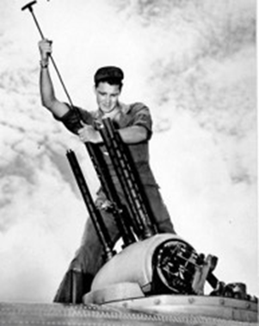
Notes:
That’s the record of officially credited enemy aircraft destruction. Post mission interrogations claimed at least as many more. Three of those gunners killed 2 MiGs each. One MiG was killed by an RB-29 Tail Gunner in November 1950, an aircraft that crashed on landing back at Yokota.
The 307th scored its fair share, with 5 of those kills to its credit:
Staff Sergeant Richard J. Fisher, 14 November 1950
Sergeant David R. Stime, 12 April 1951
Staff Sergeant Ercel S. Dye, 12 April 1951
Sergeant Fred R. Spivey, 23 October 1951
Staff Sergeant Jerry M. Webb, 23 October 1951

Slide 4
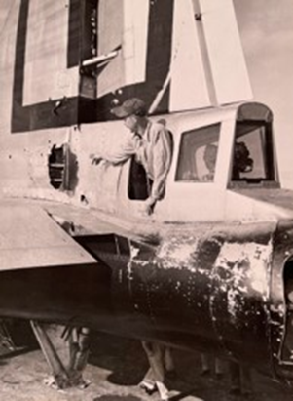
Notes:
Sergeant Webb scored his kill on the infamous Namsi raid regrettably mislabelled “Black Thursday.” Here he points to the hit by the 30mm cannon at about 100 yards that destroyed all rudder hydraulics. The MiG pilot behind that shot did not live to tell his side of the story at the fighter bar.
But air-to-air combat is not the complete story. In the last seven months of the war, one of the prime missions of the 3 B-29 Wings of Bombard Command was the destruction of airfields. As cease-fire negotiations began to show signs of progress, the Communists redoubled their efforts to repair airfields. They were aiming to deploy the 600 MiG-15s now in the hands of Chinese and North Korean Fighter units moments prior to signing the agreement that would freeze force levels at that moment in time.

Slide 5
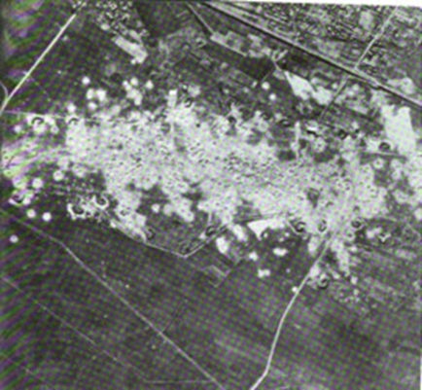
Notes:
In June and July 1953, the 307th turned Sinuiju, Uiju, and Taechon Airfields into plowed fields, destroying an estimated 100-200 MiG-15s on the ground.
I’m not sure how ops analysts would do the math, but I’m quite sure it was statistically safer to be a B-29 crewman than a MiG-15 pilot. The 307th lost 11 B-29s to MiG-15s while it destroyed at least 104 of the NATO code-named “Fagots”.

Slide 6
#2. The 307th ‘s tactics, techniques and procedures
were more agile than the communists’.
Notes:
2. The 307th ‘s tactics, techniques and procedures were more agile than the communists’.
By December 1950, the bombing campaign changed to interdiction, as UN ground forces broke contact with the Chinese hordes and made a deliberate withdrawal to the south.

Slide 7
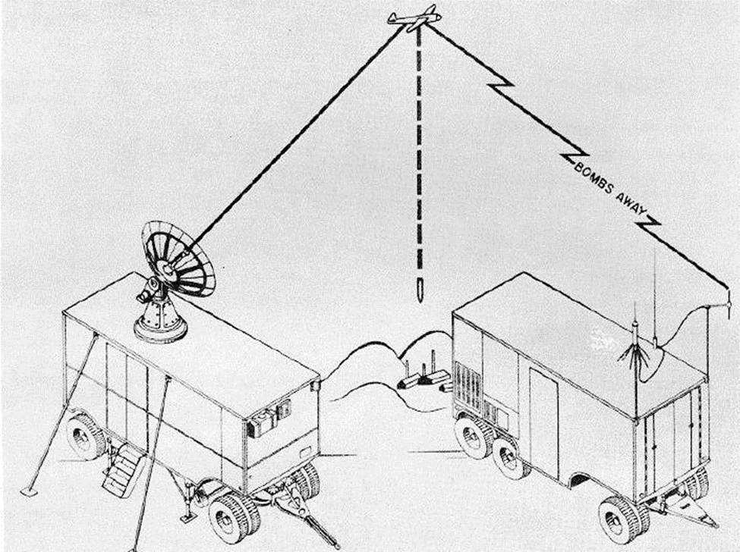
Notes:
The 307th now leveraged a technical innovation that the Air Force sent over – close air support using MPQ-6 radar. Over 16% of the 307th’s Korean War sorties were close air support. Secondary explosions gave the crews great satisfaction, and whenever ground troops assaulted those enemy positions, they reported massive numbers of dead bodies.

Slide 8
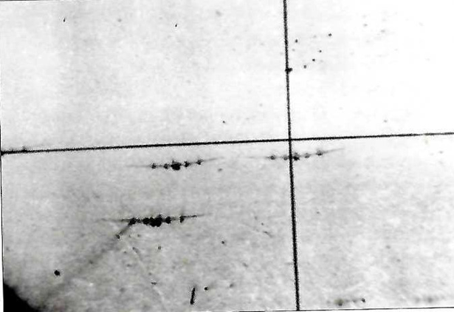
Notes:
April and October 1951 were tragic months for the 307th. The communists now employed massive swarms of MiGs to overwhelm a 9- or 12-ship strike flying in daylight formation on a visual precision bomb run. In two climactic air battles, the 307th lost 2 B-29s in an April air battle with 50 MiGs and three more in October when an estimated 150 MiGs kept the F-86s decisively engaged and totally outclassed the escorting F-84s.

Slide 9
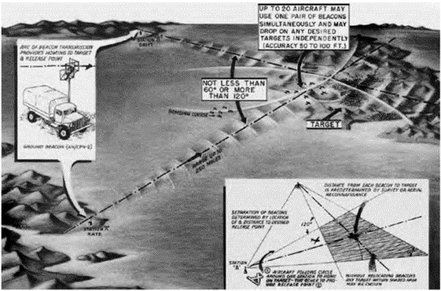
Notes:
So, the 307th immediately shifted TTP to night-time strikes using SHORAN radar employing bomber streams rather than close formations. The communists never developed a counter. By the end of the war the 307th topped BOMCOM’s SHORAN bombing effectiveness charts at over 97%.
A change in the bombing operational concept was the most consequential B-29 adaptation in the Korean War. Between August 1951 and March 1952 FEAF lost 236 aircraft while it received only 131 replacement aircraft of the types employed in the interdiction campaign.
Anyone could do the math. At these rates the US would run out of bombers before the Chinese ran out of supplies. The answer was to abandon the air campaign of continuous disruption of all supply lines. A staff study in April 1952 had shown that Destruction of only critical points was the path to victory. The revised target list produced immediate results.

Slide 10
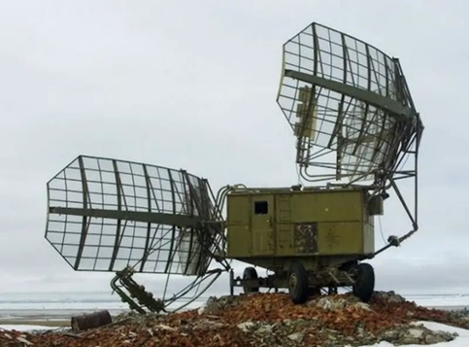
Notes:
The Soviet air defense command then developed one more innovation in late 1952. They brought in more precise and longer-range early warning and ground control radar, coupled with powerful radar-controlled searchlights. And they more than doubled the number of antiaircraft guns from around 300 to over six hundred. This gave them a couple hours’ notice to estimate what the target would be for an inbound B-29 strike. And once decided, they could concentrate their mobile flak and searchlight batteries then direct their MiG-15s to within five hundred meters of an individual aircraft.

Slide 11
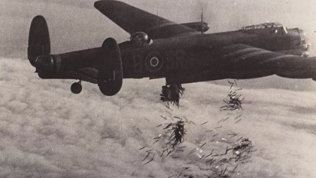
Notes:
The 307th was the leading SHORAN proficiency in BOMCOM and overcame this new Soviet concept by developing a new TTP involving multiple approaches by individual aircraft rather than a bomber stream. Lead B-29s dropped World War II era chaff to confuse enemy radar and employed ECM with jammers brought in from R&D Command. The more adventurous ECM operators could seize control of enemy searchlights and make them dance all over the airspace everywhere but on the B-29s.

Slide 12
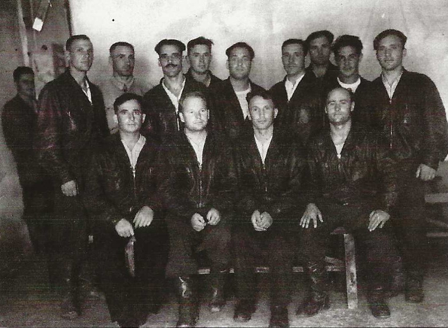
Notes:
The Soviets made one last attempt to regain air superiority. For several months in 1952 they had been training their top pilots to become – MiG-15 night fighters. Radar would track the B-29s and guide searchlights to search the night skies hoping for a reflection of the underside or vertical stabilizer. Nearby MiG-15 night fighters would get a visual fix then close on the B-29 without direction from GCI.

Slide 13
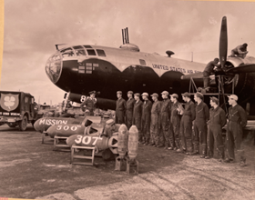
Notes:
But BOMCOM was on top of this development and countered first by painting B-29 undersides black.
With greater lateral spread, tighter vertical separation, multiple opposing IP to target approaches, the 307th could get up to twelve bombers over the target in just 1 minute. The 307th lost only 1 more B-29 to Soviet night-fighters when unexpected contrails on a moonlit night gave just enough time for searchlights to find it and MiGs to shoot down the B-29 in January 1953.
The 307th stayed inside the communist OODA-loop in the Korean War. It was a high-performing learning organization. All without a single AFSO-21 Six sigma black belt.

Slide 14
#3. There are no atheists on a B-29 Combat Mission
Notes:
3. There are no atheists on a B-29 combat mission.
This is my adaptation of the well-publicized aphorism, no atheists in trenches or foxholes. Ernie Pyle popularized it in his World War II reporting. President Eisenhower proclaimed it a “great truth” in a February 7th 1954 radio broadcast from the White House.
You certainly see it reflected in memoirs and oral histories of Korean War 307th Airmen of Jewish, Catholic and Protestant faiths. You even see it in POW testimony among Islamic prisoners among Turkish UN soldiers. Many 307th airmen interned at Pyoktong Camp 5 were beneficiaries and became believers as result of the selfless sacrifices of Medal of Honor recipient Father Emile Kapaun and his companion holocaust survivor Corporal Teddy Tobir.
In this closing insight I want to focus on the command influence on faith exerted by the 307th command and staff. It is recorded unapologetically in the unit histories, without reservation and treated as a leadership responsibility equally important as training and discipline.
At the conclusion of every mission briefing, the Wing Chaplains provided blessings and prayers for the men about to go forth into battle. Attendance was voluntary and virtually maximum. Using rotating chaplains from other units, all faiths had their own service, including Latter Day Saints. Many chaplains labored tirelessly to provide brief blessings planeside for each departing crew. Each squadron had a weekly bible or scripture study led by their own Airmen.
Despite the purges and persecution there was an extensive underground church in North Korea and many US POWs told of acts of kindness, support, and assistance in escape attempts from these brave souls.

Slide 15
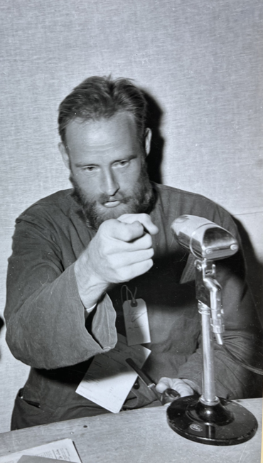
Notes:
In one of his escape attempts, the 307th’s Major David MacGhee, radar operator on the first B-29 shot down by a MiG, met a Korean woman working in the POW camp at Sombakol Valley who privately confessed to him that she was a Christian. Risking her life, she gave him some dried fish and brown sugar candy. It rejuvenated MacGhee who had thus far subsisted on a few hundred grams a day of indigestible cracked corn. On another occasion he heard a North Korean woman humming the tune to “Jesus Loves Me,” and later that night she sneaked in to give him some water and hand fed him fried mush cakes.

Slide 16
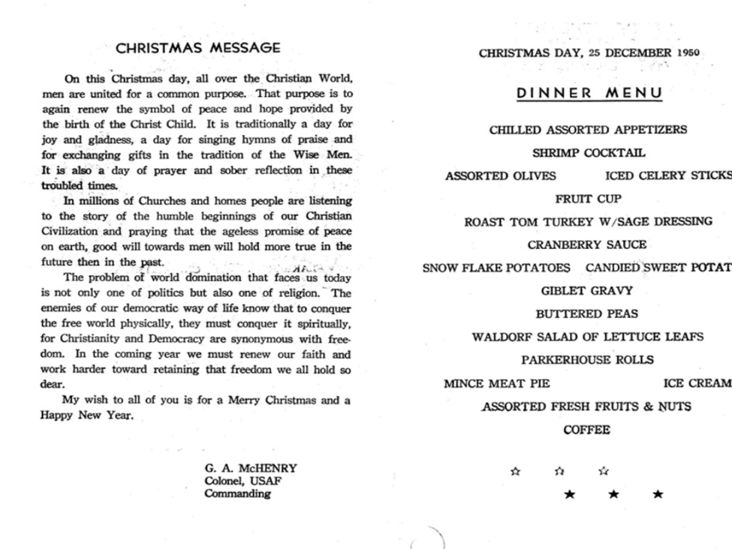
Notes:
Commanders had no reservations about inspiring their men to rely on their faith in the power of God to strengthen them for the risks they faced. The mission criticality of faith was clearly articulated by Kadena base commander Colonel G.A. McHenry in his message to the troops for Christmas 1950, printed on the facing page of the menu handed to every airman: “The problem of world domination that faces us today is not only one of politics but also one of religion. The enemies of our democratic way of life know that to conquer the free world physically, they must conquer it spiritually…In the coming year we must renew our faith and work harder toward retaining that freedom we all hold so dear.” The Air Force recognized that the fight against Communism in Korea was as much about combating the false and evil religion of communism as it was about defeating the communists in the air over North Korea.
I know you cannot do that today. But it is as true today in our fight against terrorism and today’s versions of Marxism-Leninism in Russia and China as it was in the 1950s. Perhaps we can be inspired to adapt this timeless truth to today’s conditions.

Slide 17
Three Outrageous insights
The MiG-15 did not outclass the B-29
2. The 307th’s Tactics, techniques and Procedures were more agile than the Communists’
3. There are no atheists on a B-29 combat mission
Notes:
These are three emerging insights from my research into the history of the 307th in the Korean War. The book is not yet written, so I invite your inputs and comments. Just go to my website and send me a response or drop comments on my YouTube channel as you view the videos.
In summary, the record is clear. The 307th flew 6,052 combat sorties with a 96.7% overall bombing effectiveness rate. Aircraft availability dipped on occasion, but otherwise remained consistently at 70-80 percent with a supposedly “obsolete” aircraft.

Slide 18
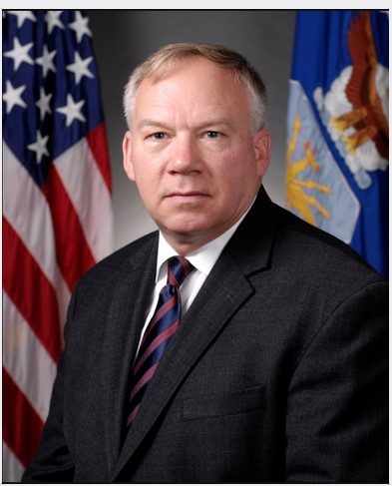
The 307th Bombardment Group Association Presents:
The History of the 307th Bombardment Wing in the Korean War:
A YouTube Narrative: https://www.youtube.com/@jamesblackwell4555/playlists
8 Detailed Episodes (Total Run Time = 3 ½ hours)
Concise Chronicle 1950 – 1954 (20 minutes)
Trailer (3 Minutes)
A work in progress. Comments welcome:
jamesblackwell@jamesblackwellauthor.com
Dr. James Blackwell
Military Analyst, Author, Lecturer
Notes:
If you were to ask me to draw a conclusion it would be this.
The airmen of the 307th suffered losses but never quit.
They gave no counsel to fear.
They became a seasoned combat outfit eager to fly into the danger zone.
They arose, flew and took the fight into the teeth of the enemy on every mission. They did it again the next day. And the next and the next and the next.
Thank you for your attention.
Roll Video: https://www.youtube.com/watch?v=hQfj4JtPKgY

